Slide 1

WEB DEVELOPMENT INTERNSHIP
Your gateway to real-world skills, hands-on projects, and verified certification.

Slide 2

Zynkcode solutions Web Development Internship Program
Learn. Build. Get Certified.
A structured, online internship program designed to take you from beginner to job-ready developer — at your own pace.

Slide 3


About Zynkcode solutions
SkillCertify is a student-focused platform built to bridge the gap between academic learning and real-world industry skills.
Academic Projects
Structured projects aligned with your curriculum and career goals.
Internship Programs
Industry-relevant internships that build your professional portfolio.
Practical Skills
Hands-on tasks that develop skills employers actually look for.
Verified Certificates
Earn certificates that validate your skills and boost your resume.
Our mission is to help students build real-world skills that matter in today's competitive job market.

Slide 4
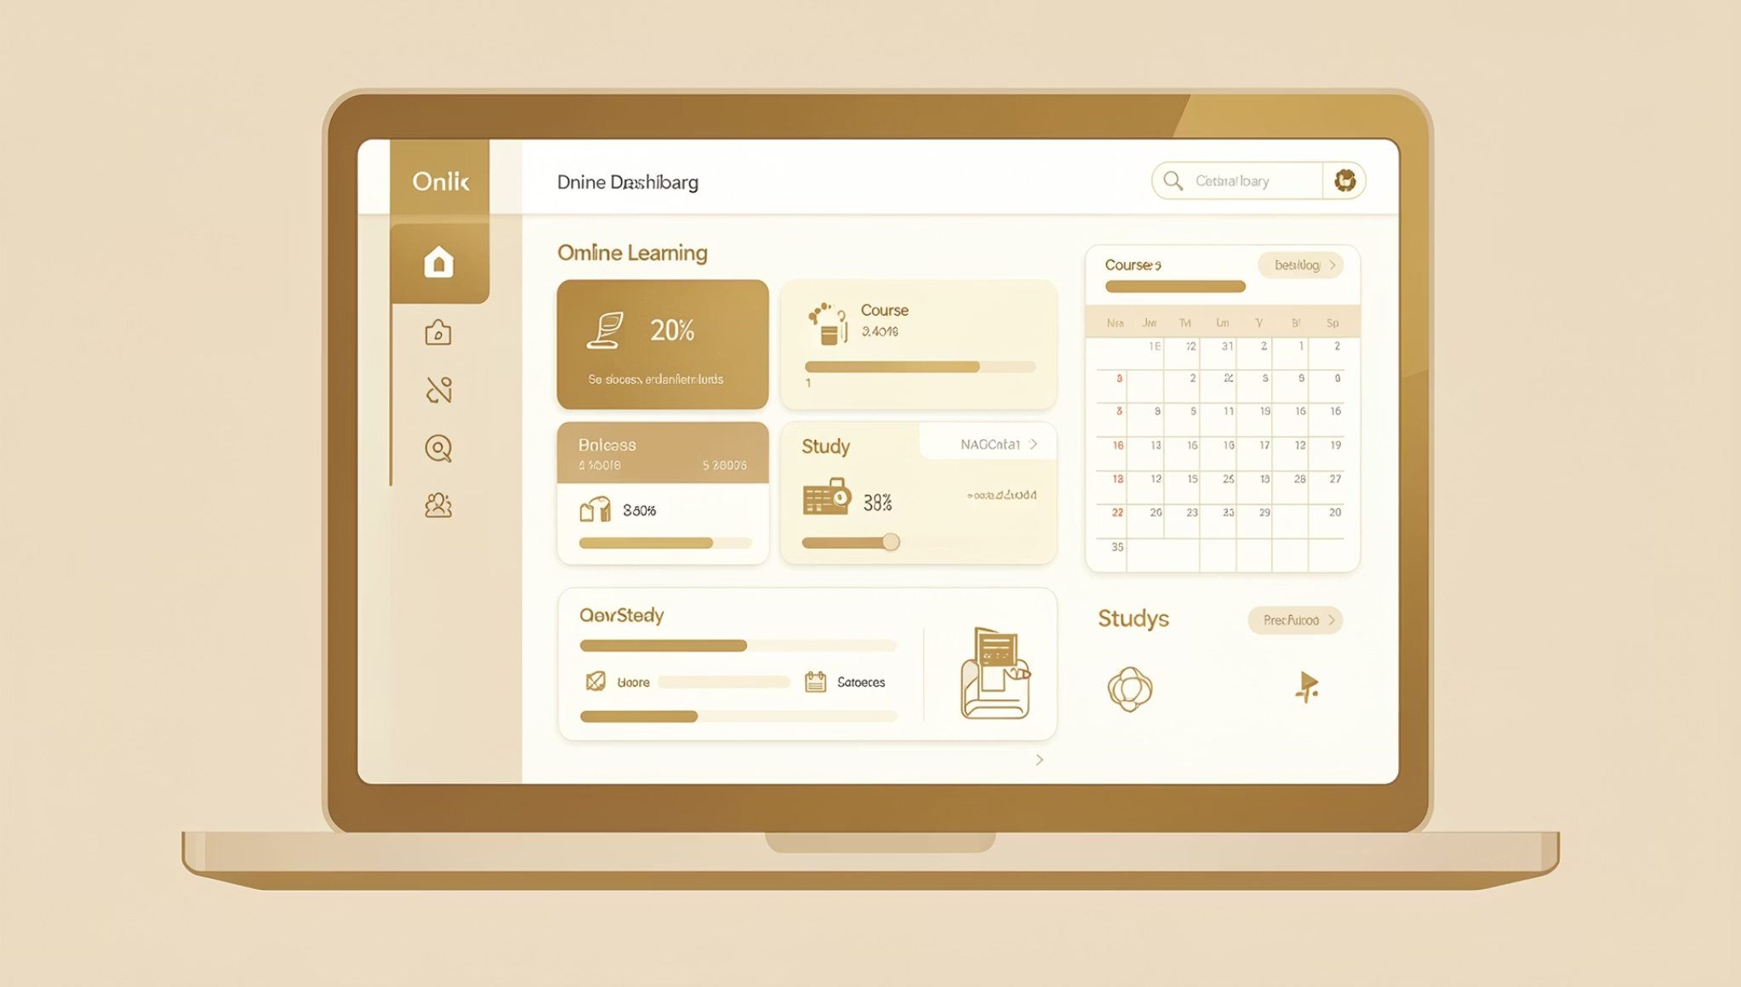
Internship Overview
Program Highlights
⏱ Duration
Flexible — work at your own pace and schedule.
🌐 Mode
Fully online — accessible from anywhere in the world.
📋 Tasks
Level-based structure with progressive difficulty.
🎓 Certificate
Provided upon successful completion of minimum 2 levels.

Slide 5

Task Structure
The internship is organized into three progressive levels. Students must complete any 2 levels to qualify for certification.
Level 1 – Basic
Foundational HTML, CSS & JavaScript tasks
Level 2 – Intermediate
Bootstrap frameworks & responsive design
Level 3 – Advanced
UI features, galleries & landing pages
Complete any 2 out of 3 levels to qualify for your verified certificate.

Slide 6
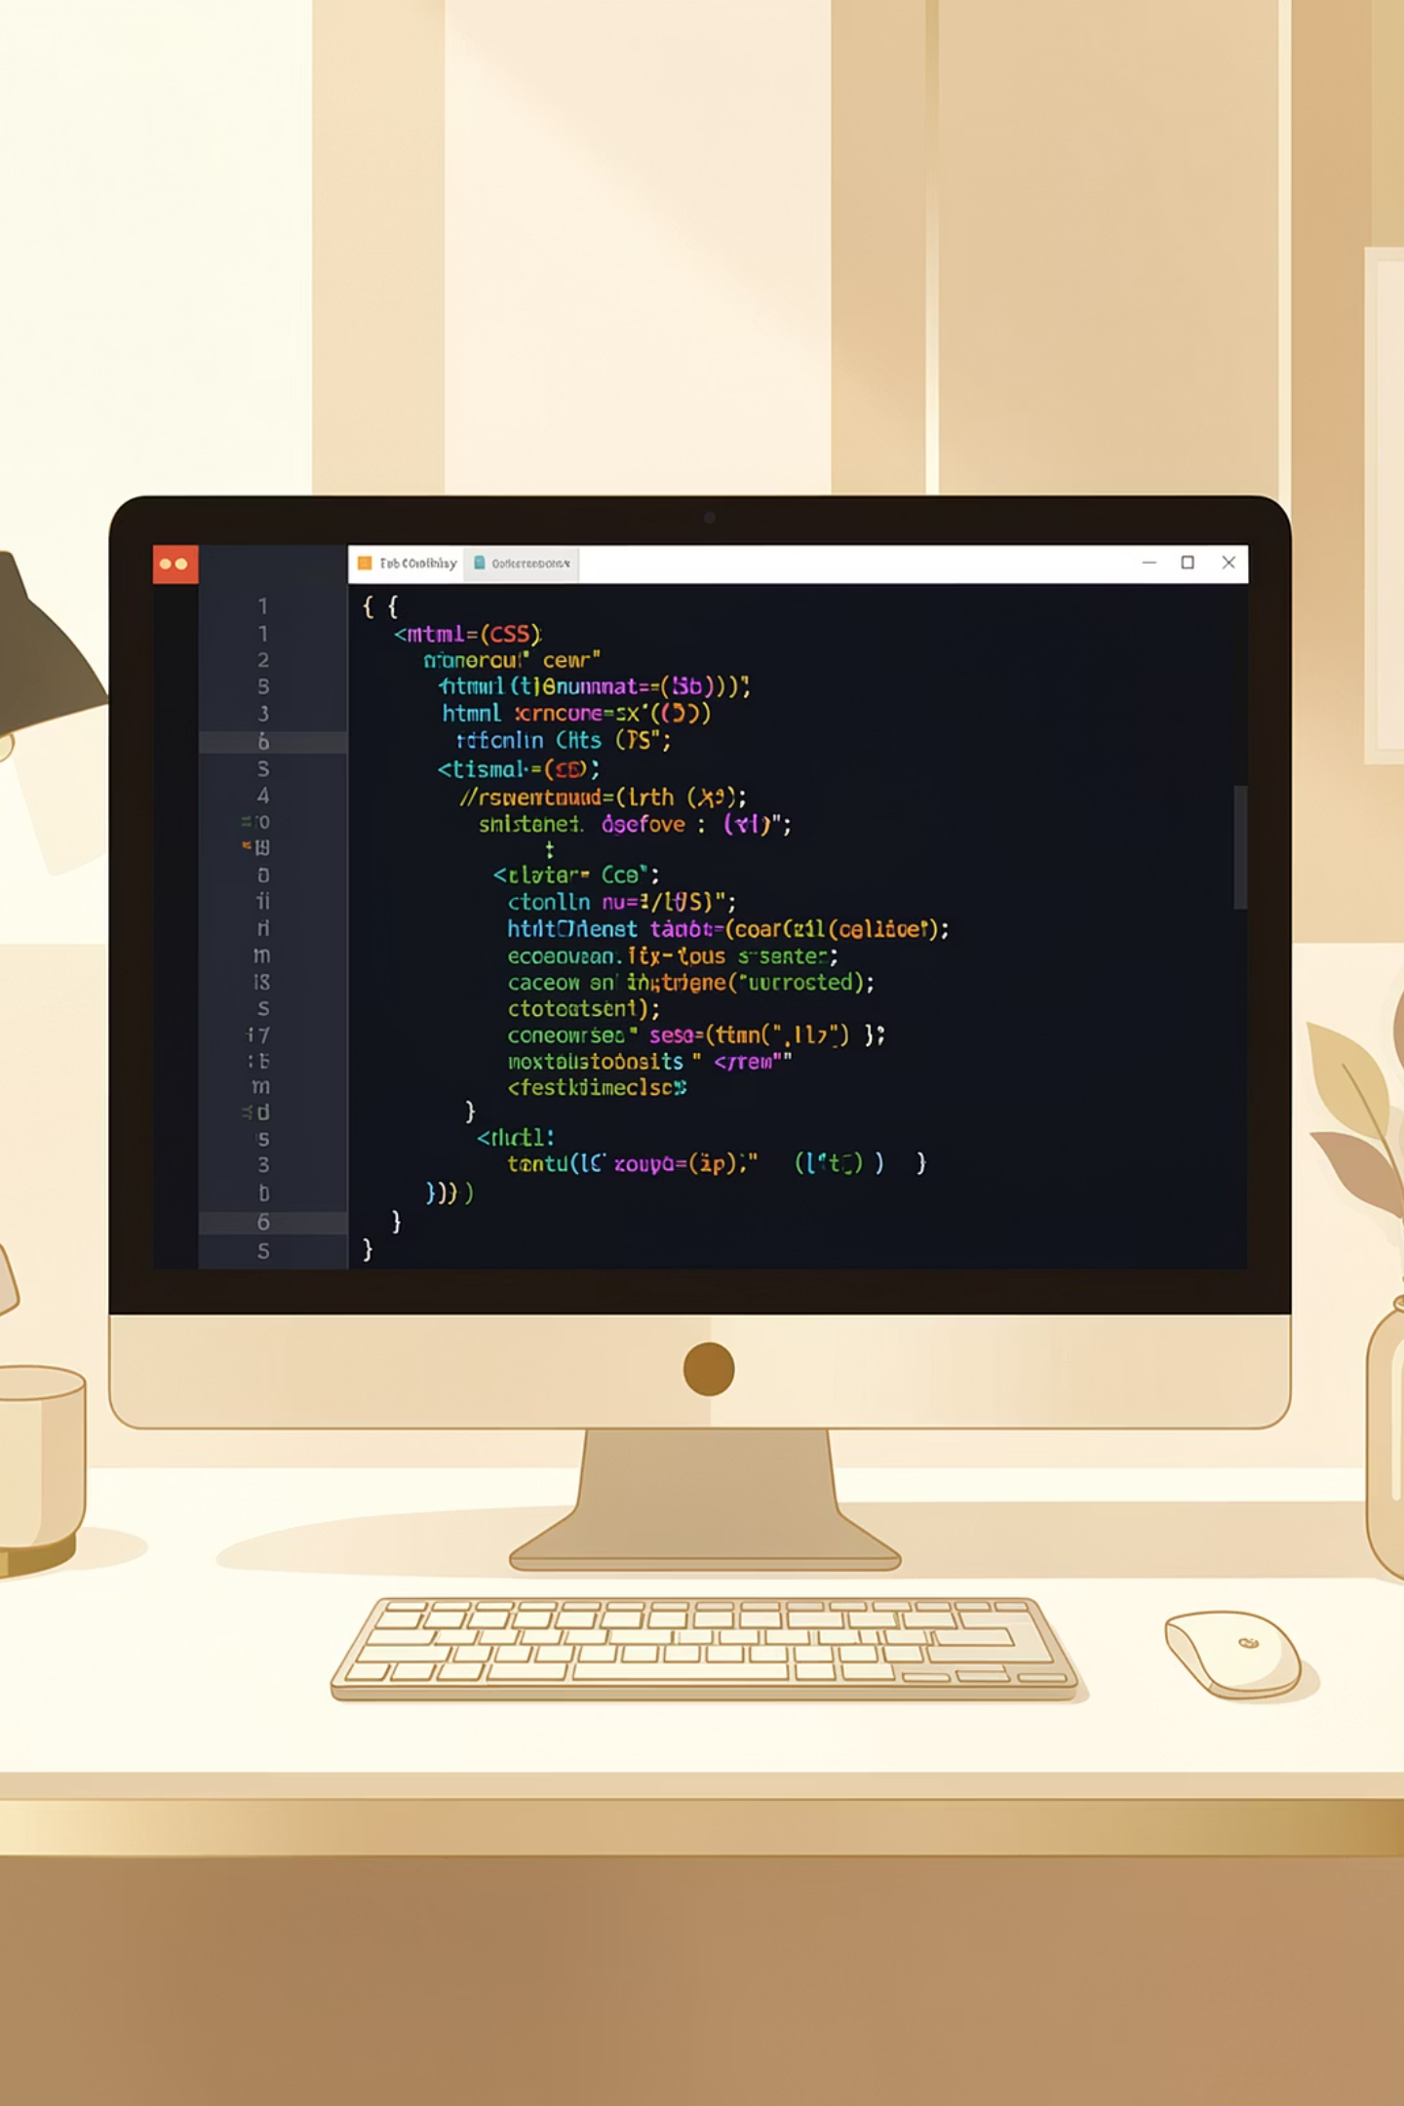
Level 1 Tasks – Basic
Build your foundation with core web technologies: HTML, CSS & JavaScript.
🎨 HTML & CSS
⚡ JavaScript
Create a simple webpage with structured content
Button color change on click interaction
Build a functional HTML form with input fields
Greeting message with dynamic user input
Create a styled navigation menu
Build a simple calculator with basic operations

Slide 7
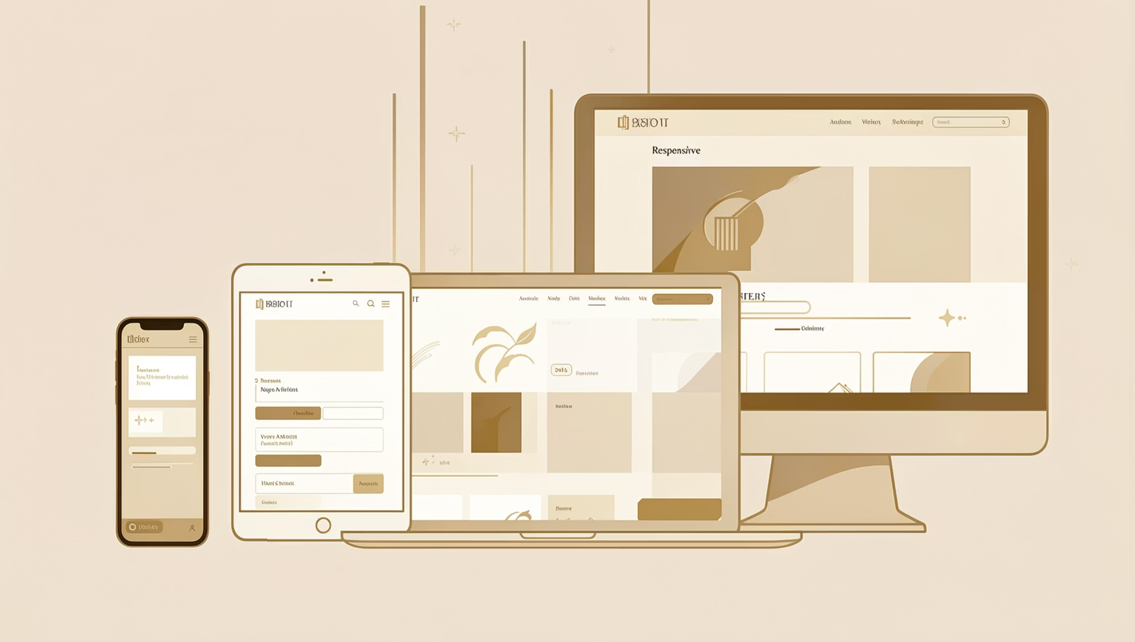

Level 2 Tasks – Intermediate
Take your skills further with frameworks and responsive design techniques.
📦 Framework
Create a responsive card component using Bootstrap
📱 Responsive Design
Make a webpage fully mobile responsive across all screen sizes
Create a functional hamburger menu for mobile navigation
Responsive design is one of the most in-demand skills in modern web development.

Slide 8

Level 3 Tasks – Advanced
Demonstrate your full skill set by building polished, production-ready UI features and a complete landing page.
🖼 Image Gallery
🎞 Image Slideshow
Design and build a visually appealing image gallery layout with clean grid structure.
Create an interactive image slideshow with smooth transitions and navigation controls.
🚀 Landing Page
Build a complete internship landing page featuring a title, description, and a compelling CTA button.

Slide 9

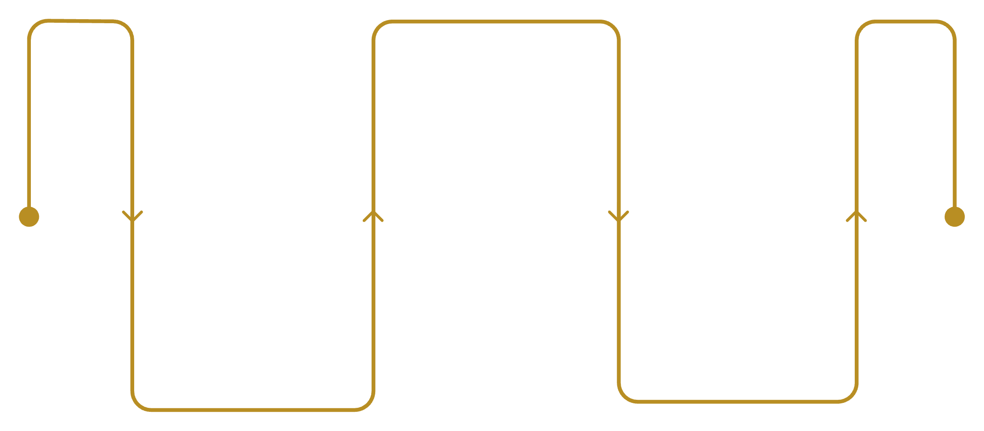
Submission Process
How to Submit Your Work
Create Demo
Record a walkthrough video
Submit Files
Upload All
Upload separate files per task
Send files and video to platform
Ensure all files are properly organized and your demo video clearly walks through each completed task before uploading to the platform.

Slide 10


Earn Your Certificate
Complete the program requirements and receive your verified Zynkcode solutions certificate — a credential that proves your real-world web development skills.
Complete Minimum 2 Levels
Submit All Tasks
Choose any 2 of the 3 levels — Basic, Intermediate, or Advanced — and complete all tasks within them.
Upload your completed task files and demo video to the SkillCertify platform for review.
Get Verified & Certified
Once your submission is verified, your official certificate will be issued and ready to share.
Ready to start? Join SkillCertify today and take the first step toward a verified web development career.

